Slide 1
Reinforcement Learning
Sofian fadli, s.t. | session v

Slide 2
Reinforcement Learning
Reinforcement Learning is a branch of Machine Learning, also called Online Learning. It is used to solve interacting problems where the data observed up to time t is considered to decide which action to take at time t + 1. It is also used for Artificial Intelligence when training machines to perform tasks such as walking. Desired outcomes provide the AI with reward, undesired with punishment. Machines learn through trial and error.

Slide 3
Reinforcement Learning
Upper Confidence Bound (UCB)
Thompson Sampling

Slide 4
Upper Confidence Bound
Session i

Slide 5
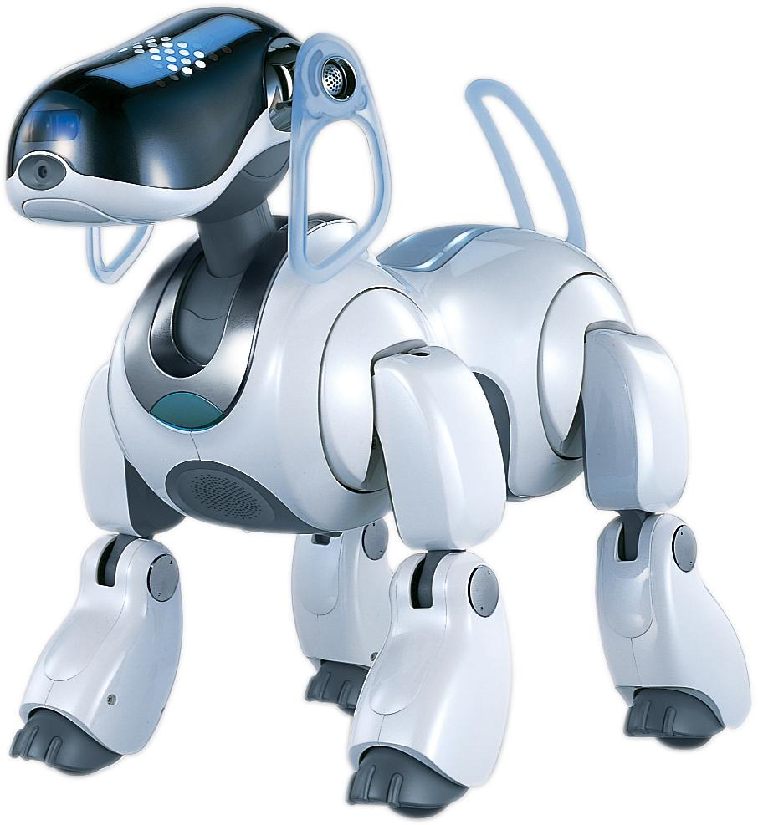
Walk
Reward
Punishment

Slide 6
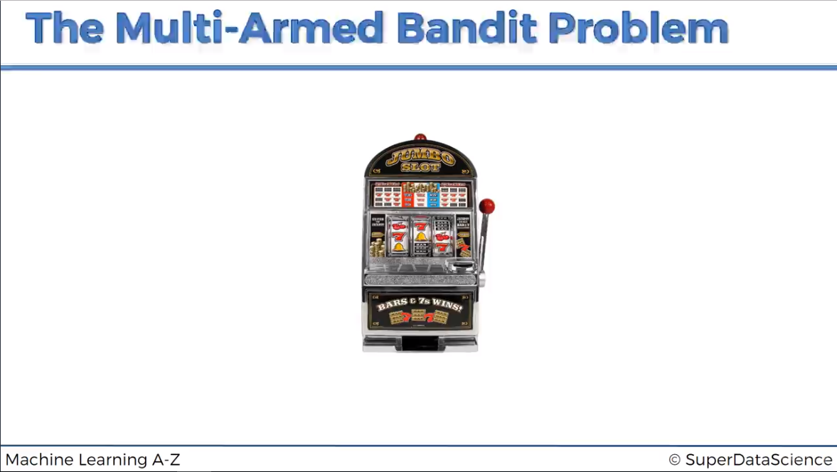

Slide 7
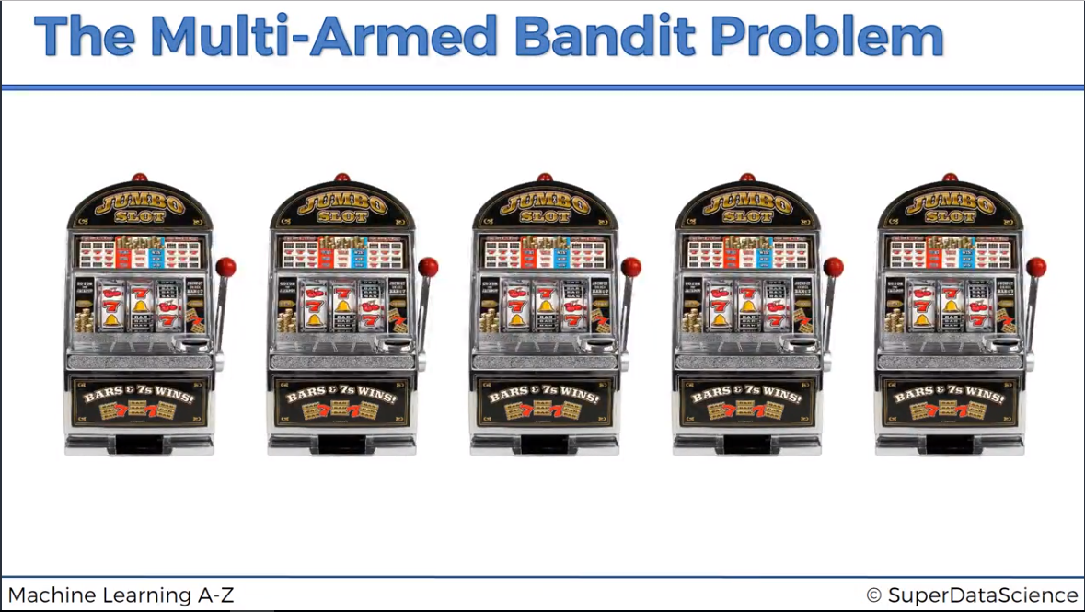

Slide 8
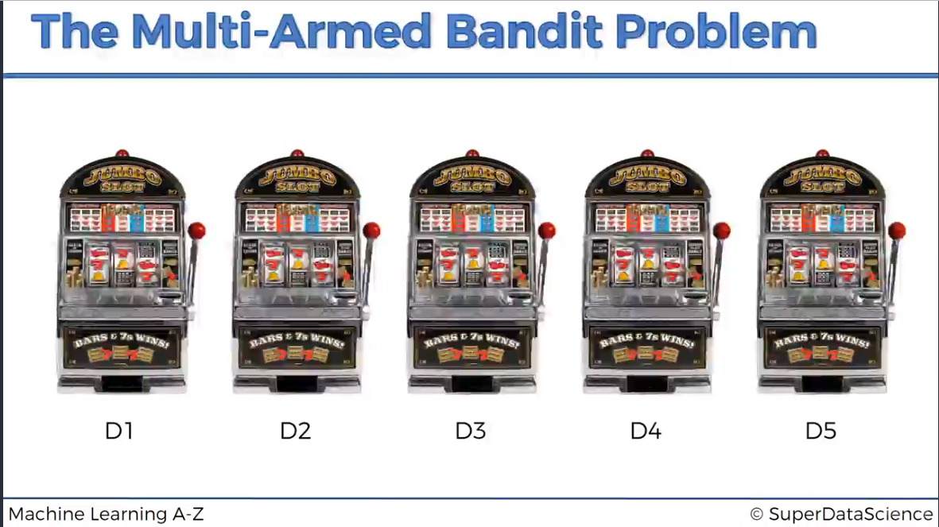

Slide 29
Upper Confidence Bound
Coding session

Slide 30
THOMPSON SAMPLING
Session II

Slide 35
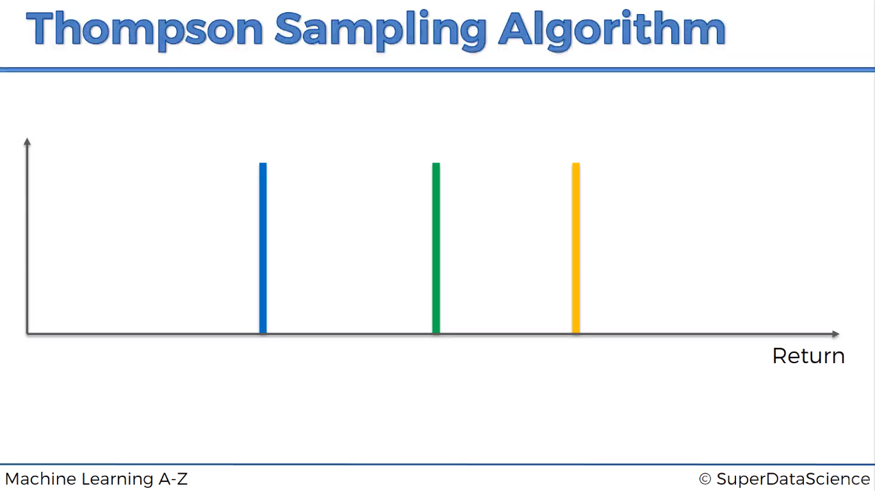

Slide 36


